Slide 1




Plus Ultra
Fitness Tracking App

Slide 2

Problem Statement
The absence of a user-centric fitness tracking application leaves individuals without effective tools to manage their physical activities and health. We aim to address this by creating a comprehensive Fitness Tracking Application.

Slide 3
Vision & Executive Summery
Our vision is to empower users in their health and fitness journey through a user-friendly Fitness Tracking Application, offering not only activity tracking but also personalized fitness plans, nutritional tools, and community support.
Product: Fitness tracking app.
Objective: Successfully launch and marketing the app for athletes in need for a tracking dashboard of their goal.
Target Audience: Athletes in general, and dieters.

Slide 4
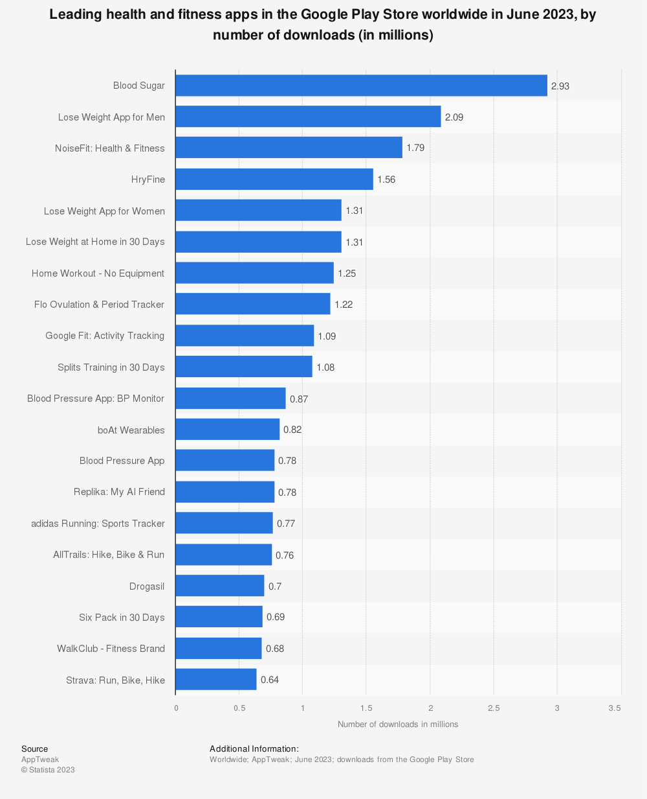
Benchmark
Leading health and fitness apps in the google play store worldwide in June 2023, by number of downloads (in millions)

Slide 5
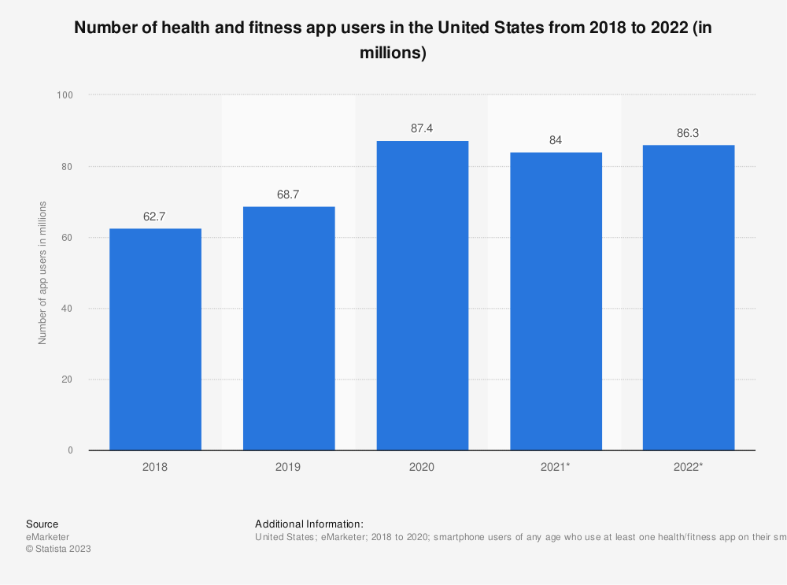
Market Size
According to the global fitness apps market these are the estimated market size in the US which will be 60%-80% applicable in the middle east:
28% conversion rate
Of the top 100 fitness apps (Apple), only 5% have a rating lower than 4 stars.
Daily active users (DAU) should be around 9.41%.
Average retention rate of 7% after one month
Top-grossing fitness apps rake in $2 to $6 million per month worldwide.

Slide 6

User Research
After searching multiple users research from other famous fitness apps(UBFit), I found the following needs of the users:
Food Macro list and Calorie Count.
Customize workout plans.
Workout videos with instructor.
Motivational music.
Workout plans as per target areas.
Diet plan, workout exercise and track progress.
Reminders and timers.
Different types of workout options.

Slide 7
Features and Prioritization
Activity Tracker: Log workouts, steps, and exercises, visualize progress.
01
Personalized Plans: AI-generated fitness and nutrition plans based on goals.
02
Calorie Calculator: Estimate daily caloric needs, aiding dietary choices.
03
BMI Tracker: Monitor BMI, gain body composition insights.
04
Community Hub: Forums, challenges, and progress sharing to boost motivation.
05

Slide 8
Technical Requirements
User Profile: provides the ability to track fitness goals, dashboards with earned achievements.
Workouts: Provides sufficient data for all exercises, workouts calendar, easy navigation within app.
Fitness Goal and Route: automatically set achievements marker , provide health stats.
Notifications: Provide quick action for starting the workout, keep log of all user notifications, of course allow user to manage notification types and customize them.
Educational content: provide clear and high educational content about workouts and meal preps.
Integration with other services: Smart watches and more.

Slide 9
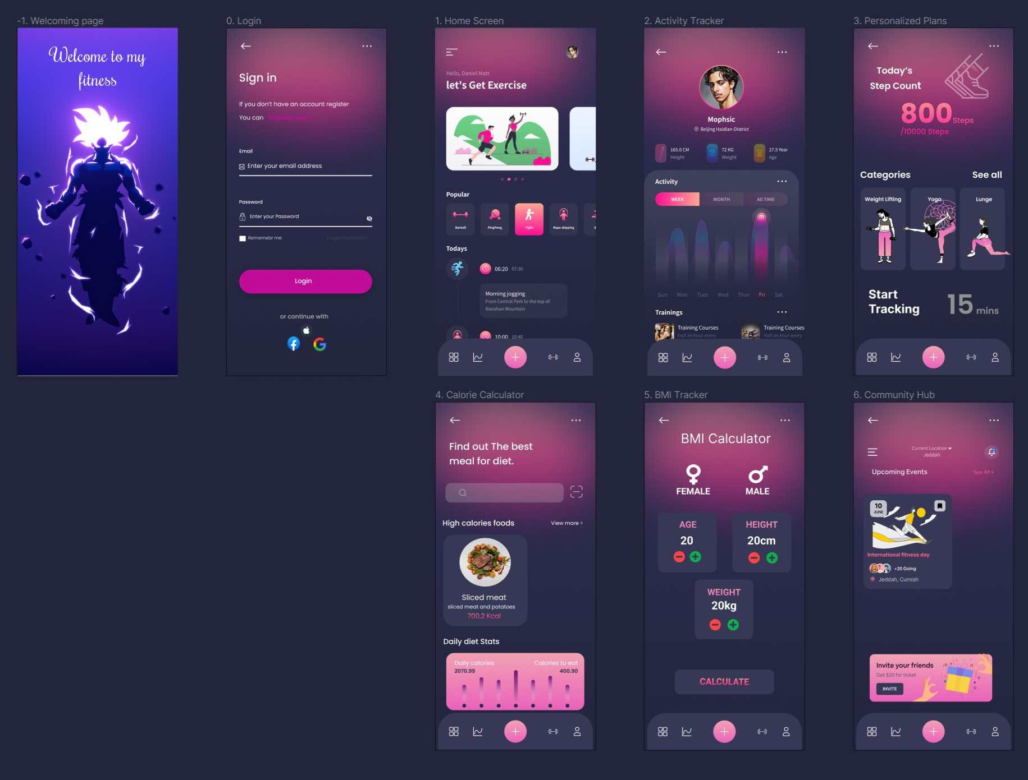
UX design Sample

Slide 10
Distribution Channels
Channel | Pre-Lunch | Lunch | Post-Lunch
Application | Build pleasing app for athletes. | Landing page (create account/sigh-in). | Keep updating app and add new features.
 | Implement tracking tool for user behavior. | Enable free-try for subscriptions. | Analyze user data to improve app.
Social Media | Generate social media ads. | Generate opening ceremony | Make new offers and ads.
 | Collaborate with industry influencers. | Run online ads through influencers. | Maintain good relationships with influencers and sake new ambassadors.
Community | Lunch a mystery event for the app. | Add new challenges with rewards. | Keep making championships and challenges to establish a community.
Customer | Create customer success funnel. | - Collect and analyze post-launch customer feedback. | Identify and address customer pain points and generate new solutions.

Slide 11
Revenue Model
Subscription | Features Included | Price range
Basic | Activity tracking. | Free
 | General workouts plans.
 | Calories calculator for daily intake.
 | BMI calculator.
 | Community challenges.
Premium | Everything in basic. | 5$ a month
 | Specific goal-oriented workouts plans.
 | Calories estimation for long term goal.
 | Community Challenges and being listed and awarded middles based on activity completion.
Athlete | Everything in Premium | 10$ a month
 | Personalized workout plan with education and experts’ advice.
 | Diet plan building based on calories need and health goal.
 | BMI tracker with professional insights on progress.
 | Community and educational platform with experts’ advice.

Slide 12
Business Objectives
Targeted
outcome in
1-year
Generate 500k or more in revenue.
Acquire 25k active users.
Acquire 5k subscribed users.
Achieve 4.5-stars rating in app stores.

Slide 13
Extra Links
UX design (Figma): https://www.figma.com/file/rSFGppSnrMkSbuqa0Rc1KT/DPDM-A2?type=design&node-id=0%3A1&mode=design&t=LX8tP3IVlggea6hE-1
Product Development Roadmap (Jira): https://mahmuedalardawi.atlassian.net/jira/polaris/projects/PDR/ideas/view/338

Slide 14

FAQ

Slide 15
END

